Slide 1
Chapter 7
Process control
Summer course: Embedded Linux System.

Slide 2
Content:
7.1. Signal handler.
7.2. Sleep.
7.3. Start of process.
7.4. States of process.
7.5. Daemon.
7.6. System log.
Summer course: Embedded Linux System.

Slide 3
Content:
7.1. Signal handler.
7.2. Sleep.
7.3. Start of process.
7.4. States of process.
7.5. Daemon.
7.6. System log.
Summer course: Embedded Linux System.
Notes:
Copyright Act Brain Co.

Slide 4
7.3. Start of process
7.3.1. Shell command execution.
7.3.2. Pipe stream open.
7.3.3. Pipe stream close.
Summer course: Embedded Linux System.

Slide 5
7.3.1 Shell command execution (subroutine)
■system()
#include <stdlib.h>
int system(const char *command);
  const char* ： Execute the specified command in the form of /bin/sh -c command.
  Return value Return -1 if error. Otherwise, return the status of the command.
■Notes
Signal SIGCHLD is blocked while executing the command, and SIGINT and SIGQUIT are disregarded.
Because the execution result is output to a standard output, it is not possible to use it by the program as it is.
Summer course: Embedded Linux System.
Notes:
■About system
・When the command to be executed is passed by the argument, the system function can execute it as it is.
・This function ends, too, if the specified command ends.
・If &(ampersand) is put on the command, it is possible to process it by the background.
■Notes
・Signal SIGCHLD is blocked while executing the command, and SIGINT and SIGQUIT are disregarded.
・If you want to use the execution result by the program because the execution result is output to a standard output, we use the
popen function which is explained as follows.

Slide 6
■system use sample
#include <stdio.h>
#include <stdlib.h>
int main( )
{
if(system("ls -l")==-1){
perror("system");
return -1;
}
return 0;
}
Summer course: Embedded Linux System.
Notes:
・The sample program displays directory information by using the system function.

Slide 7
7.3. Start of process
7.3.1. Shell command execution.
7.3.2. Pipe stream open.
7.3.3. Pipe stream close.
Summer course: Embedded Linux System.

Slide 8
7.3.2 Pipe stream open for I/O with process (Subroutine)
■popen()
#include <stdio.h>
FILE *popen(const char *command,
const char *type);
  *command ： Execute the specified command in the form of/bin/sh ?c command.
  *type ： Specify either of reading (r) or writing (w).
  (Because the pipe is one direction, the specification of both direction is improper. )
  Return value Return NULL when the fork or pipe call fails or the memory allocation cannot be done.
Summer course: Embedded Linux System.
Notes:
Popen (Next, explain) and pclose (explained before) can use as if the pipe function is added to the system function.
The execution result of a certain command can be used to input another command by using the pipe.
・Close with not fclose(3) but pclose() though the return value from popen() is the same as a usual standard I/O stream.
The result of writing in this stream is written in a standard input of the command.
And, a standard output of the command becomes the same as standard output of the process where popen() was called as long as the command is not replaced. Oppositely, reading from the “popened” stream (It was opened by popen()) becomes reading a standard output of the command.
And, a standard input of the command is the same as a standard input in the process where popen() was called.

Slide 9
7.3. Start of process
7.3.1. Shell command execution.
7.3.2. Pipe stream open.
7.3.3. Pipe stream close.
Summer course: Embedded Linux System.

Slide 10
7.3.3 Pipe stream close for I/O with process (subroutine)
■pclose()
#include <stdio.h>
int pclose(FILE *stream);
  *stream ： Stream
  Return value when wait4 or other errors are found ： -1
Summer course: Embedded Linux System.

Slide 11
■popen use sample
#include <stdio.h>
#include <string.h>
int main()
{
char str[512],*ptr;
FILE *fp;
if((fp=popen("netstat","r"))==NULL){
printf("popen error\n");
return(-1);
}
while(1){
fgets(str,512,fp);
if(feof(fp)){
break;
}
// \n is converted into \0.
ptr=strchr(str,'\n');
if(ptr!=NULL){
*ptr='\0';
}
printf("popen result %s\n",str);
}
pclose(fp);
return(0);
}
Summer course: Embedded Linux System.
Notes:
・The sample program acquires statistical information related to the network by using the popen function, and displays the content from the program.

Slide 12
Content:
7.1. Signal handler.
7.2. Sleep.
7.3. Start of process.
7.4. States of process.
7.5. Daemon.
7.6. System log.
Summer course: Embedded Linux System.
Notes:
Copyright Act Brain Co.

Slide 13
7.4. State of process
7.4.1. Start of child process.
7.4.2. Execute the program.
7.4.3. Function execve( ).
7.4.4. Wait for process.
7.4.5. Practice execersise.
7.4.6. Summary.
Summer course: Embedded Linux System.

Slide 14
7.4.1 Start of child process (system call)
■fork()
#include <unistd.h>
pid_t fork(void);
  Return value PID of the child process is returned to the parent process when succeeding in the creating of the child process, and 0 is returned to the child process.
  -1 is returned to the parent process when failing, and the child process is not generated.
Summer course: Embedded Linux System.
Notes:
・Only one direction of either reading or writing to the command can be executed because the popen function was able to have only one pipe. When we want to have two pipes, and to do both reading and writing to the command, it is necessary to make processing that starts the child process while preparing the pipe for ourselves.
・We learn how to create the child process here to do it first and later we learn how to use pipe when we learn the interprocess communication.

Slide 15
7.4. State of process
7.4.1. Start of child process.
7.4.2. Execute the program.
7.4.3. Function execve( ).
7.4.4. Wait for process.
7.4.5. Practice execersise.
7.4.6. Summary.
Summer course: Embedded Linux System.

Slide 16
7.4.2 Execute the program.
■exec*()
int exec ( ・・・ ) ;
Kind of exec() | PATH variable | Specification of argument | Can the environment variable be passed as an argument?
execl | not referred. | Specify as an individual argument | Not passed
execv | not referred. | Specify as an individual array | Not passed
execle | not referred. | Specify as an individual argument | Can pass
execve | not referred. | Specify as an individual array | Can pass
execlp | can refer | Specify as an individual argument | Not passed
execvp | can refer | Specify as an individual array | Not passed
■exec*() list
Notes:
・Exec() is a generic name of the system call and the library function in which the program is executed.
When we execute exec(), the program specified is overwritten in the process and executed.
Therefore, it doesn't return to processing that executes exec after it succeeds in the start of the program for which exec is
specified.
・There are six kinds of exec as being in the list.
The content specified for the argument differs depending on the kind of exec, and specifies the executed program name etc.
・Exec is classified by the following three functions.
①Whether the PATH variable must be referred to when you specify the path name of the program file or not?
In the referred one, "p" is included in the system call name like execlp and execvp, etc.
②Whether do we specify as a list of two or more arguments given to the program to execute, or do we specify it as a string array?
As for the one specified for an individual argument, "l" is included in the system call name like execl, execle, and execlp, etc.
As for the one specified for an array argument, "v" is included in the system call name like execv, execve, and execvp, etc.
③Whether the environment variable can be passed as an argument or not?
As for the one that it is possible to pass it, "e" is included in the system call name like execle and execve, etc.

Slide 17
7.4. State of process
7.4.1. Start of child process.
7.4.2. Execute the program.
7.4.3. Function execve( ).
7.4.4. Wait for process.
7.4.5. Practice execersise.
7.4.6. Summary.
Summer course: Embedded Linux System.

Slide 18
7.4.3. Function execve( ):
#include <unistd.h>
int execve(const char *filename,
char *const argv[], char *const envp[]);
  *filename ： Executed program
  *const argv[] ： Array of argument character string passed to new program
  *const envp[] ： Array of environment variable character string passed to new program
  Return value Execve() is not returned when succeeding. Return -1 if error.
Summer course: Embedded Linux System.
Notes:
・Execve() executes the program specified by filename.
・It is necessary to end both argv and envp as notes with the NULL pointer.

Slide 19
7.4. State of process
7.4.1. Start of child process.
7.4.2. Execute the program.
7.4.3. Function execve( ).
7.4.4. Wait for process.
7.4.5. Practice execersise.
7.4.6. Summary.
Summer course: Embedded Linux System.

Slide 20
7.4.4. Wait for the change in the state of the process (system call).
■wait()
#include <sys/types.h>
#include <sys/wait.h>
pid_t wait(int *status);
  *status ： When the child process is a normal end
  Eight high rank bits: End status
  Eight subordinate position bits ： 0
  When the child process ends with the signal
  Eight high rank bits ： 0
  Eight subordinate position bits: Signal number of cause of end
  Macro that operates value of status
  WIFEXITED()： True when ending with exit and return.
  WEXITSTATUS() ： Obtain the end status.
  WIFSINALED() ： True when ending with signal
  WTERMSIG() ： Obtain the value of the signal.
  Return value Success：Process ID of child process Error：-1
Summer course: Embedded Linux System.
Notes:
・wait() function waits state transition of the child process, and is used to get information of child process which state changes.
State transition means that terminating child process, pausing child process by signal, resuming child process by signal.
To call wait() function, the system will release the resources of child process, when child process terminate.
If wait() function is not called, the resources of child process keep remaining as defunct state.
・When state transition of the child process already occurs, wait() function call is returned at once.
If state transition of the child process has not occurred, wait() function process is blocked until when state transition of the child process occurs or wait() function is terminated by signal handler.

Slide 21
7.4.4. Wait for the change in the state of the process (system call).
●What is the state transition of the child process?
End of child process
Stop of child process with signal
Restart of child process with signal
Summer course: Embedded Linux System.

Slide 22
■ Fork, exec, and wait use sample program concept chart
Processing is executed.
fork
Parent process processing
Child process processing
wait
exec
Summer course: Embedded Linux System.
Notes:
・Create the child process by the fork processing while executing the main processing
・Parent process enters the wait state for the state transition of the child process by wait.
・Execute exec in the child process, and end the child process.
・Because the child process ended, the parent process restarts processing.

Slide 23
■Fork, exec, and wait use sample
#include <stdio.h>
#include <stdlib.h>
#include <unistd.h>
#define PROC_OK 0
#define PROC_NG -1
/**
* The main processing
*/
int main(void)
{
printf("main : start\n");
char *args[] = {"ls", "-l", NULL};
int iRet = 0;
pid_t pid = 0;
int status = 0;
// Creating child process
switch (pid = fork()){
case -1:
// Process creating error processing
perror("processGenerate fork");
exit(1);
case 0:
// Child process processing
iRet = execv("/bin/ls", args);
// It doesn't pass when execv succeeds.
printf("execv ret = %d\n", iRet);
if(iRet == PROC_NG)
{
exit(1);
}
default:
// Parent process processing
printf("Parent Process ChildProcPid = %d\n", pid);
// Wait for the state transition of the child process.
pid=wait(&status);
printf("pid=%d,status=%d\n", pid, status);
break;
}
printf("main : end\n");
return 0;
}
Summer course: Embedded Linux System.
Notes:
The sample program waits for the child process creating, processing in the child process, and the child process processing end by using fork, exec, and wait.
・It enters the state that the child process is generated in the part where fork is executed, and two processes of parents and the
child are executed.
・Because the return value after fork is executed is 0, the child process can be judged.
End the process after executing execv by processing case 0 that is the divergence of the switch sentence in the sample, and executing the ls command.
・The parent process is -1 whose return value after fork is executed is an error. Or, it is possible to judge it because not 0 that is the child process.
Wait for the state transition of the child process by wait in the processing of default that is the divergence in the sample for switch. Restart processing after the state of the child process changes and end the main function.

Slide 24
7.4. State of process
7.4.1. Start of child process.
7.4.2. Execute the program.
7.4.3. Function execve( ).
7.4.4. Wait for process.
7.4.5. Practice exercise.
7.4.6. Summary.
Summer course: Embedded Linux System.

Slide 25
7.4.5. Practice exercise
Confirm the following by using fork, exec, and the wait use sample program.
１．Confirm operation when execv is replaced with other exec * and other Linux commands.
２．Confirm the operation when kill pid is executed from the console and the child process is ended (Do not execute exec in the child process).
３．Confirm the state of the process of the child process when wait is not used by the parent process, and the child process ends.
４．Make the program that generates, and ends two or more child processes.
Summer course: Embedded Linux System.

Slide 26
7.4. State of process
7.4.1. Start of child process.
7.4.2. Execute the program.
7.4.3. Function execve( ).
7.4.4. Wait for process.
7.4.5. Practice execersise.
7.4.6. Summary.
Summer course: Embedded Linux System.

Slide 27
Debugging Multiple Processes
When the fork() is used, GDB can take two scenarios (courses of action).
Control by using: “follow-fork-mode” command.
GDB can continue to control and debug the parent process.
GDB can stop debugging the parent process and attach to the newly formed child process.
Tip 1: Can you describe about two scenarios (courses of action)?
Summer course: Embedded Linux System.
Notes:
For the lecture:
Answer for two courses of action: GDB can continue to control and debug the parent process, or it can stop debugging the parent process and attach to the newly formed child process.
The comment for “Control by using: “follow-fork-mode” command.”: The two modes are follow parent and follow child. The default behavior is for GDB to follow the parent. In this case, the child process executes immediately upon a successful fork.

Slide 28
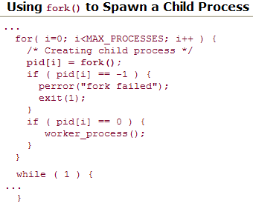
Debugging Multiple Processes
/* Parent gets non-zero PID */
/* Indicates child's code path */
/* The forked process calls this */
/* Parent's main control loop */
Summer course: Embedded Linux System.
Notes:
For the lecture:
This simple loop creates MAX_THREADS new processes using the fork() system call. Each newly spawned process executes a body of code defined by the function worker_process(). When run under GDB in the default mode, GDB detects the creation of the new threads of execution (processes) but remains attached to the parent's thread of execution. Following slide illustrates this GDB session.

Slide 29
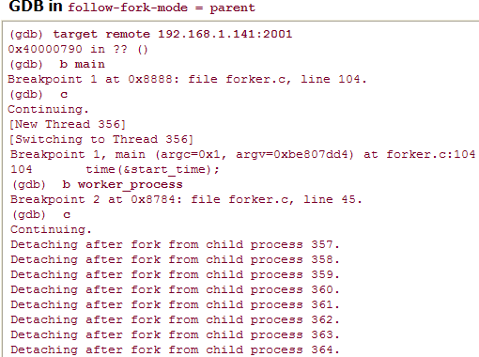

Question: Which is PID of parent processes?
Summer course: Embedded Linux System.
Notes:
For lecture:
Answer for question: the PID is 356. See sentences: “[New Thread 356] [Switching to Thread 356]”.
If you simply need to follow the child process, set the follow-fork-mode to follow child before your parent reaches the fork() system call.

Slide 30
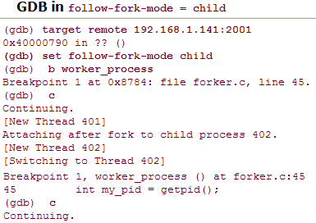
First child process is debugged, but what happened with the other child processes?
Which is the PID of parent process and first child process?
Summer course: Embedded Linux System.
Notes:
For the lecture:
Here we see the parent process being instantiated as PID 401. When the first child is spawned by the fork() system call, GDB detaches silently from the parent thread of execution and attaches to the newly spawned child process having PID 402. GDB is now in control of the first child process and honors the breakpoint set at worker_process().
The other child processes spawned by the above code are not debugged and continue to run to their own completion.

Slide 31
Tracing and Profiling tool:
Some tools offer a high-level perspective:
  what processes are running on your system
  which processes are consuming the most CPU bandwidth.
Others can provide detailed analysis:
  where memory is being allocated or, even more useful.
  where it is being leaked.
Summer course: Embedded Linux System.

Slide 32
Strace Tool:
Captures, displays useful information for “system call” executed by a Linux application program.
Can be run on programs without source code.
Not necessary to recompile and/or debug the program with GCC, GDB.
strace can be a very insightful educational tool.
As the man page states, "Students,
hackers and the overly-curious
will find that a great deal can be
learned about a system and its
system calls by tracing even
ordinary programs."

Slide 33
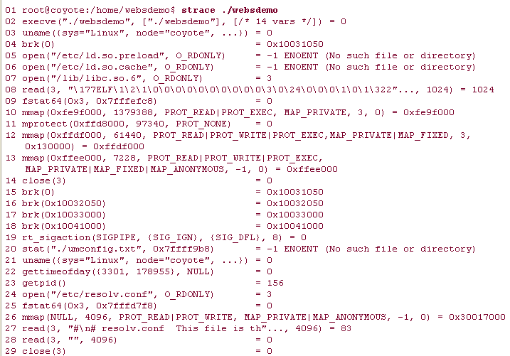
Try to use strace with one program: Websdemo
Line numbers have been added to the output
produced by strace to make this listing
more readable.

Slide 34
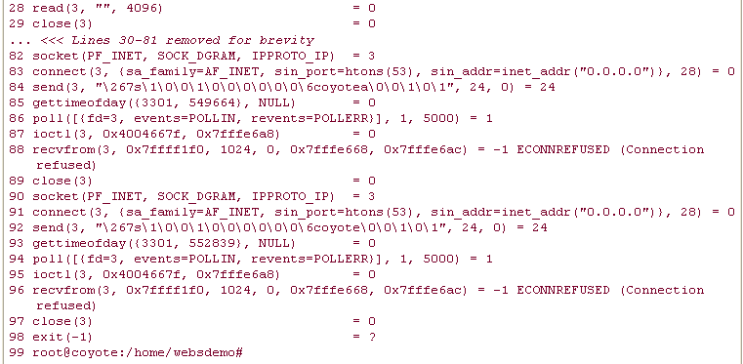

Slide 35
several open() system calls to /etc/ld.so.*,
which are the Linux dynamic linker-loader
(ld.so) doing its job
In line 20, the program is looking
for a configuration but did not
file one.
Lines 24 through 29 open and read a Linux
system file containing instructions for
the DNS service to resolve hostnames.

Slide 36

Attaching to a Running Process
connect to a process to examine its state while it is running instead of killing the process and starting it again.
Use the detach at almost any time to end the debug session and leave the application running on the target.
Notes:
For the lecture:
When you are finished examining the process under debug, you can issue the gdb detach command. This detaches the gdbserver from the application on the target and terminates the debug session. The application continues where it left off. This is a very useful technique for examining a running program. Be aware, though, that when you attach to the process, it halts, waiting for instructions from you. It will not resume execution until instructed to do so, using either the continue command or the detach command. Also note that you can use the detach command at almost any time to end the debug session and leave the application running on the target.

Slide 37
7.4.6. Summary
The Linux command can be executed by starting the process when system and popen are used.
Processing can be branched by generating the child process when fork is used.
Summer course: Embedded Linux System.

